Slide 1









User Generated Content Analytics Clustering & Topic Modeling (aka Latent Dirichlet Allocation) Fall 2018, October 16, 18
Dr. Anitesh Barua
David Bruton Jr. Centennial Chair Professor in Business
Distinguished Fellow, INFORMS Information Systems Society
University of Texas Distinguished Teaching Professor
Associate Director, Center for Research in e-Commerce
McCombs School of Business, University of Texas at Austin
Email: aniteshb@gmail.com

Slide 2





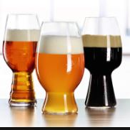

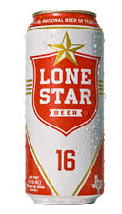

A Bit More on Cosine Similarity: Building Recommendation Systems
Source: Kyle Katzen et al. (MSBA, 2017)
Notes:
Gihani
Took surveys of 10 beers

Slide 3
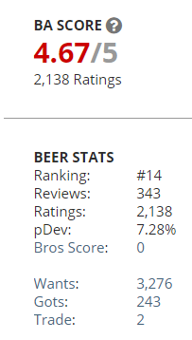
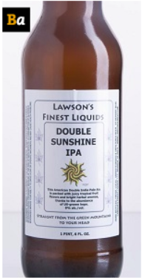
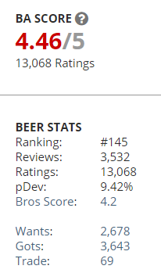
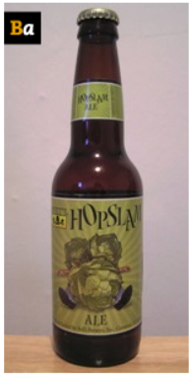
The “Long Tail” Visibility Problem
Similar beers (found using cosine similarity of descriptions),
but one has much higher demand
Double Sunshine IPA | Lawson's Finest Liquids
Hopslam Ale | Bell's Brewery, Inc.
Great product,
but not well known
(visibility problem)
Very good product,
very well known
Source: Kyle Katzen et al. (MSBA 2017)
Notes:
Kyle
Answer to previous slide is that it depends how you define popular!
Better marketing and increasing production would really help the double sunshine

Slide 4
Clustering with Text
Grouping documents that are “similar”
How to measure similarity between documents?
Many approaches: Euclidean distance, cosine similarity
Similarity within a “cluster”
Similarity between “clusters”
Not a “supervised” method: I.e., no accuracy of prediction or classification
A cluster has to be interpreted

Slide 5
Business Applications
Grouping customer comments
E.g., customer complaints
Ideas provided by customers (e.g., ideastorm.com)
Discussions on product forums or review pages
Finding similar products (e.g., movies, cameras, apps, etc.)
Check movie_clustering.py

Slide 6
Clustering Top 100 IMDb Movies Based on Synopses
Preprocess descriptions
Transform data into vector space using tf-idf (or other approaches)
Calculating Euclidean distance or cosine similarity between each document
Cluster using k-means clustering
Use MDS and visualize
Source: http://brandonrose.org/clustering

Slide 7
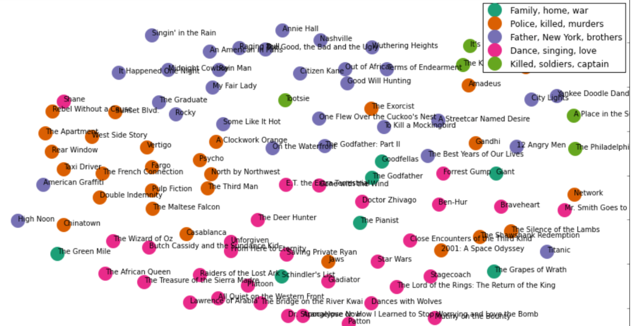
MDS of Top 100 Movies
Source: http://harrywang.github.io/document_clustering/

Slide 8
1 Document, 1 Topic?
What are the topics in these documents?
“I like to eat broccoli and bananas.” → Food
“I ate a banana and spinach smoothie for breakfast.” → Food
“Chinchillas and kittens are cute.” → Cute pets
“My sister adopted a kitten yesterday.” → Cute pets
“Look at this cute hamster munching on a piece of broccoli.” → Cute pets & food
Latent Dirichlet Allocation (LDA): a way of automatically discovering topics that these docs contain
Topics are “latent” (hidden) – they have to be discovered

Slide 9
The Key Ideas
Topics and words
Topic A: 30% broccoli, 15% bananas, 10% breakfast, 10% munching, …
Topic B: 20% chinchillas, 20% kittens, 20% cute, 15% hamster, …
Documents and topics
Documents 1 and 2: 100% Topic A
Documents 3 and 4: 100% Topic B
Document 5: 60% Topic A, 40% Topic B

Slide 10
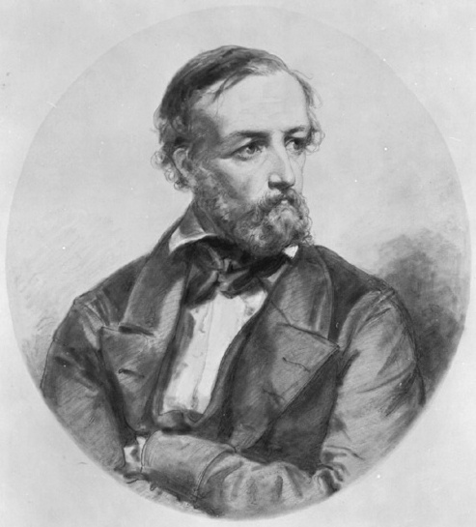
LDA Assumptions: A Bit of Theory (FYI only)
LDA represents documents as mixtures of topics
Topics contain words with certain probabilities
Documents were created as follows:
For each document, the author decided on
the number of words N (e.g., according to a Poisson distribution)
a topic mixture (according to a Dirichlet distribution over a set of K topics)
E.g., a document may have 1/3 food topic and 2/3 cute animals topic
The author generated each word in a document by:
Choosing a topic (according to the distribution above)
E.g., food topic with 1/3 probability & cute animals with 2/3 probability
Generate words (according to the topic’s distribution).
E.g., for the food topic, generate the word “broccoli” with 30% probability, “bananas” with 15% probability, etc.
Assuming this generative model for a collection of documents, LDA then tries to backtrack from the documents to find a set of topics that are likely to have generated the collection of docs.
Peter Gustav Dirichlet
1805-1859

Slide 11
Clustering Vs. Topic Modeling
A document must belong to one cluster only
Cluster described by words unique to that cluster
Important words:
politics, election, president
Important words:
illegal, terrorism, wall
Important words:
jobs, rust, outsourcing
Doc 5
Doc 8
Doc 9
Doc 1
Doc 3
Doc 2
Doc 4
Doc 6
Doc 7
Doc 10
Cluster 3
Cluster 1
Cluster 2
Copyright Anitesh Barua 2018

Slide 12
Topic Modeling
Completely different approach
May come up with the same keywords as clustering
But a document can have more than one topic
Important words:
politics, election, president
Important words:
jobs, rust, outsourcing
Important words:
illegal, terrorism, wall
Topic 1
Topic 2
Topic 3
70%
30%
Doc 1
Doc 3
Doc 2
Doc 5
Doc 4
Doc 6
Copyright Anitesh Barua 2018

